Slide 1
Chapter 11
Systems design

Slide 2
Learning objectives
After this lecture, you will be able to:
  define the difference between analysis and design and the overlap between them;
  synthesise the relationship between good design and good-quality information systems;
  define the way relational databases are designed;
  evaluate the importance of the different elements of design for different applications.

Slide 3
Management issues
From a managerial perspective, this lecture addresses the following questions:
  What different types of design need to be conducted for a quality BIS to be developed?
  What are the key aspects of design for an
  e-business system?
  How do we create an effective information architecture for our organisation?

Slide 4
Systems design
Systems design: The design phase of the lifecycle defines how the finished information system will operate.
This is defined in a design specification of the best structure for the application and the best methods of data input, output and user interaction via the user interface.
The design specification is based on the requirements collected at the analysis stage.

Slide 5
Current design challenges
Delivering web-based applications over intranet, extranet and internet
Integration of data from disparate sources (ERP)
Providing access to unstructured information (knowledge management).

Slide 6
Aims of system design
Design a good-quality information system that
  is easy to use;
  provides the correct functions for end-users;
  is rapid in retrieving data and moving between different screen views of the data;
  is reliable;
  is secure;
  is well integrated with other systems.

Slide 7
Technical constraints on design
Hardware platform (PC, Apple or Unix workstation).
Operating system (Windows XP, Apple or Unix/Linux).
Web browsers to be supported (different versions of Microsoft Internet Explorer and open source rivals such
as Opera, Mozilla, Firefox, etc.).
Data links required between the application and other programs or a particular relational database such as Oracle or Microsoft SQL Server.
Design tools such as CASE tools.
Methodologies or standards adopted by the organisation, such as SSADM.
Industry standards such as data exchange using XML.

Slide 8
Technical constraints on design (Continued)
System development tools or development environments for programming, such as open-source technology or proprietary tools such as Microsoft Visual Studio.
Number of users to be supported concurrently and the performance required.
Scalability: The potential of an information system, piece of software or hardware to move from supporting a small number of users to a large number of users without a marked decrease in reliability or performance.
Plus, of course, user and business needs from requirement specification.

Slide 9
Hofer – three stages of design strategy
Design strategy: A high-level statement about the approach to develop an information system. It includes statements on the system’s functionality, hardware and system software platform, and the method of acquisition.
Dividing requirements (from the analysis phase discussed in the previous chapter) into sets of essential requirements and optional requirements which may be built into future versions.
Enumerating different potential implementation environments (hardware, system software and network platforms discussed in Chapters 3, 4 and 5).
Proposing different ways to source or acquire the various sets of capabilities. For example, outsourcing, purchase of pre-existing applications software or development of new capabilities as discussed in Chapters 7 and 8 of this text.

Slide 10
The relationship between analysis and design
There is often a considerable overlap between analysis and design.
A distinction is often made between the logical representation of data or processes during the analysis stage and the physical representation at the design stage.
For example the entity relationship diagram of the analysis phase will be turned into a physical database table definition at the design phase.
A logical entity ‘customer’ will be specified as a physical database table ‘Customer’ in which customer records are stored. Similarly, the dataflow diagram will be transformed into a structure chart indicating how the different submodules of the software will interact at the design stage.

Slide 11
Design types
Top-down design: The top-down approach to design involves specifying the overall control architecture of the application before designing the individual modules.
Bottom-up design: The bottom-up approach to design starts with the design of individual modules, establishing their inputs and outputs, and then builds an overall design from these modules.
Validation: This is a test of the design where we check that the design fulfils the requirements of the business users which are defined in the requirements specification.
Verification: This is a test of the design to ensure that the design chosen is the best available and that it is error-free.

Slide 12
Process and data modelling
Process modelling: Involves the design of the different modules of the system, each of which is a process with clearly defined inputs and outputs and a transformation process. Dataflow diagrams are often used to define processes in the system.
Data modelling: Data modelling involves considering how to represent data objects within a system, both logically and physically. The entity relationship diagram is used to model the data.

Slide 13
Major elements of design
1. Overall design or system design: What are the best architecture and client/server infrastructure? The overall design defines how the system will be broken down into different modules and how the user will navigate between different functions and different views of the data.
2. Detailed design of modules and user interface components: This defines the details of how the system will operate. It will be reviewed by looking at user interface and input/output design.
3. Database design: How to design the most efficient structure using normalisation.
4. User interface design: How to design the interface to make it easy to learn and use. For web-based systems this includes the information architecture.
5. Security design: Measures for restricting access data and safeguarding data against deletion.

Slide 14
1. System design
System or outline design: A high-level definition of the different components that make up the architecture of a system and how they interact.
  Systems architecture: The design relationship between software applications, hardware, process and data for an information system.
Detailed or module design: Detailed design involves the specification of how an individual component of a system will function in terms of its data input and output, user interface and security.

Slide 15
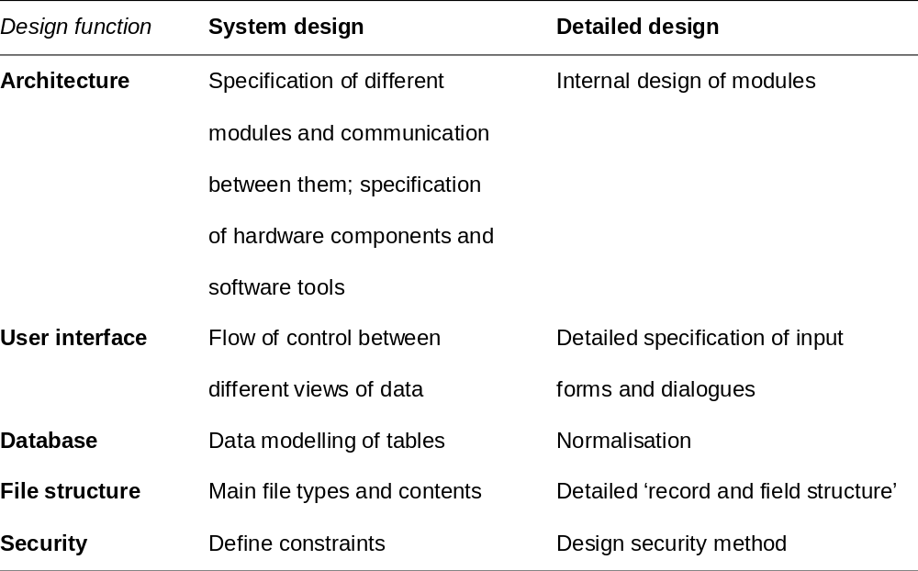
System and detailed design
Table 11.1 Comparison between the coverage of system and detailed design

Slide 16
2. Detailed or module design
Module design includes:
  how the user interface will function at the level of individual user dialogues;
  how data will be input and output from the system;
  how information will be stored by the system using files or a database.
Detailed design is sometimes divided further into external and internal design.
  External design refers to how the system will interact with users.
  Internal design describes the detailed workings of the modules.

Slide 17
3. Database design
1. Database: All information for one business application (normally made up of many tables). Example: sales order database.
2. Table: Collection of records for a similar entity. Example: all customers of the company within the sales order database. Other tables in the database are product and order.
3. Record: Information relating to a single instance of an entity (comprising many fields). Example: single customer such as Poole.
4. Field: An attribute of the entity. Example: customer name or address for a particular customer such as Poole.

Slide 18
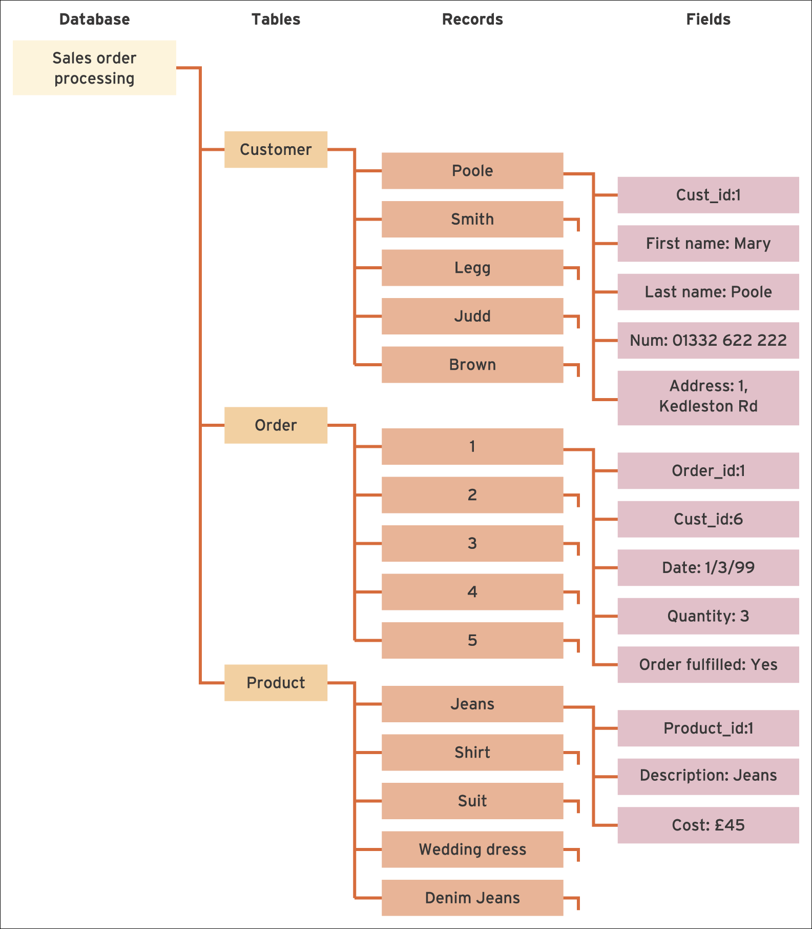
Figure 11.7 Diagram illustrating the tree-like structure used to structure data within a relational database. This example refers to the Clothez database. The fields are only shows for the first record in each table

Slide 19
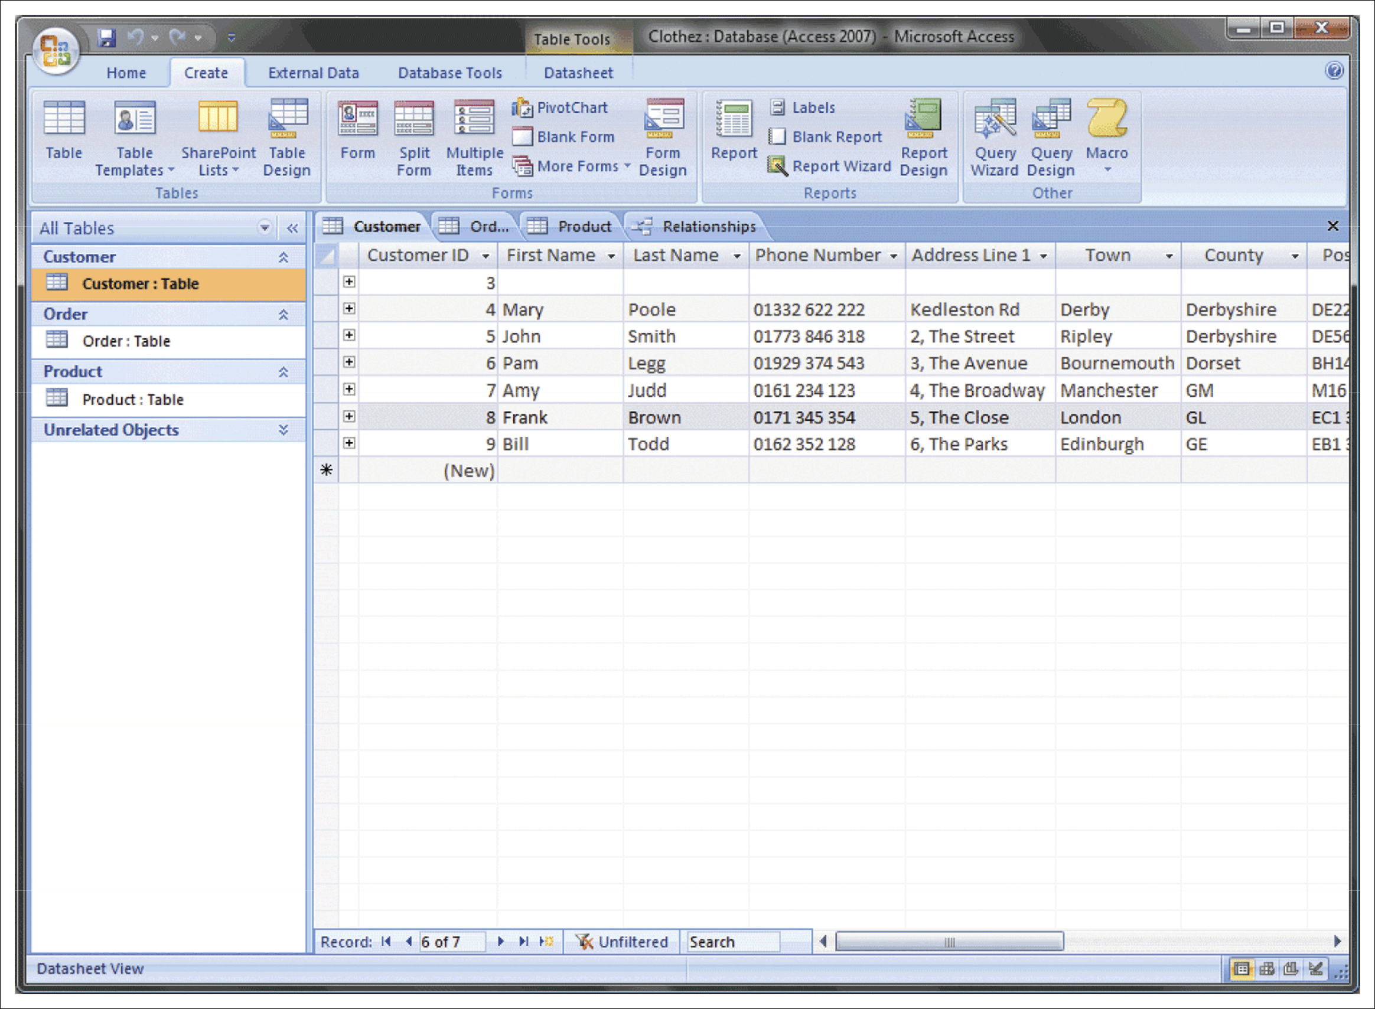
Figure 11.8 Clothez database in Microsoft Access
Source: Screenshot frame reprinted by permission from Microsoft Corporation

Slide 20
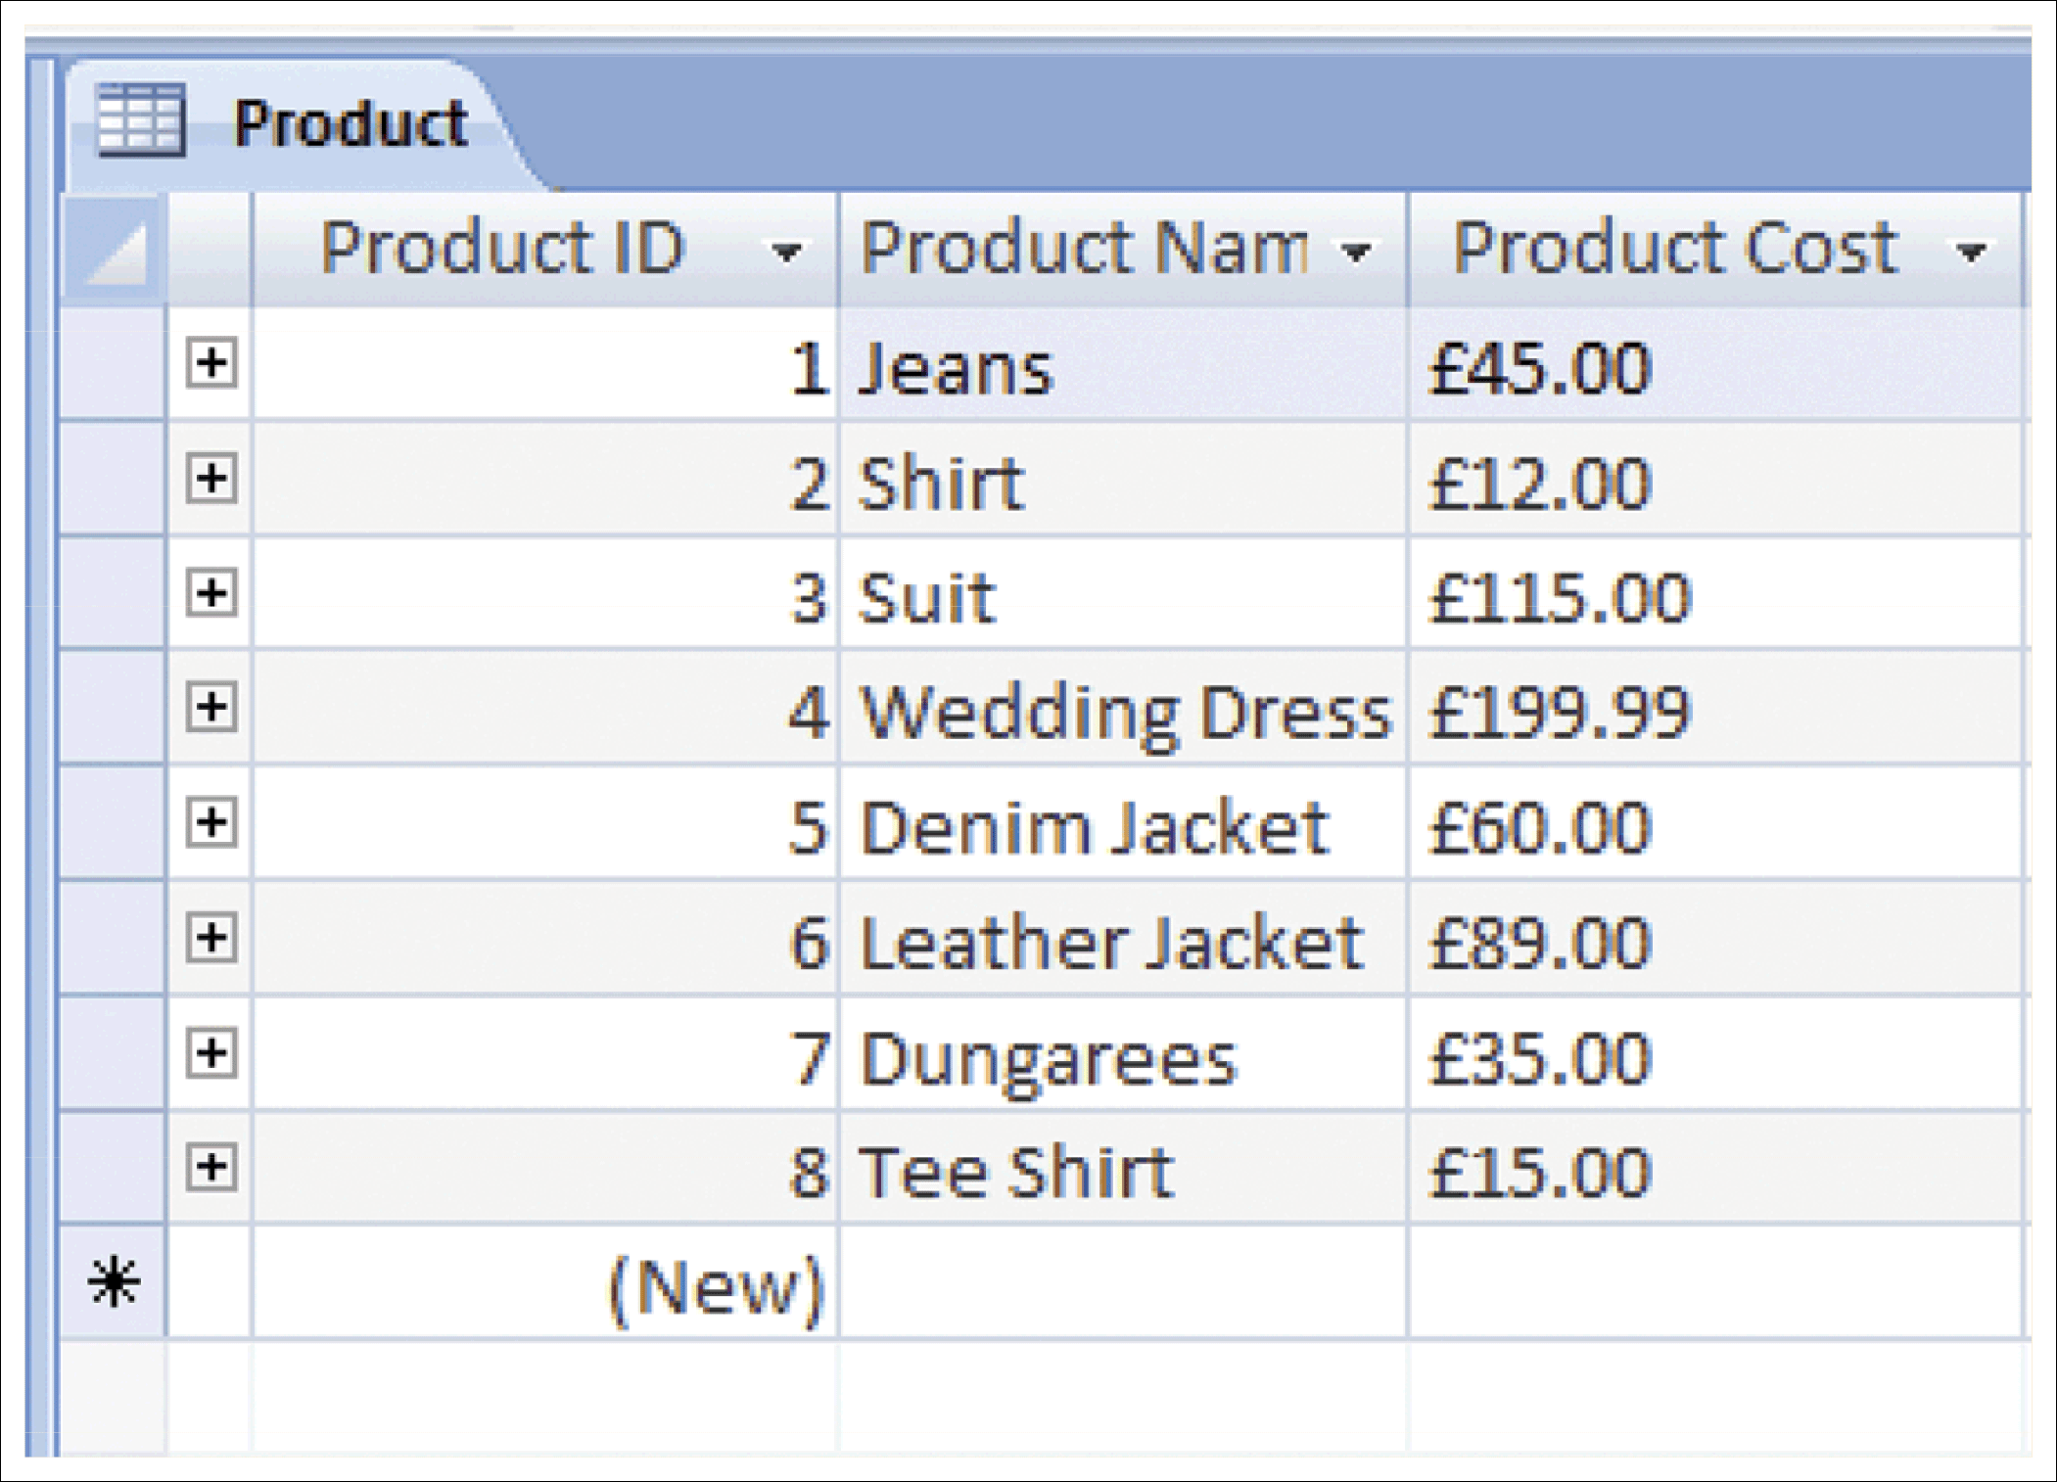
Figure 11.9 Product table showing records and fields
Source: Screenshot frame reprinted by permission from Microsoft Corporation

Slide 21
Key fields
Key field: This is a field with a unique code for each record. It is used to refer to each record and link different tables.
Primary key fields: These fields are used to uniquely identify each record in a table and link to similar foreign key fields (usually of the same name) in other tables.
Secondary or foreign keys: These are used to link tables by referring to the primary key of another table.

Slide 22
Rules for assessing keys
1. Primary keys
The primary key provides a unique identifier for each record.
There is usually one primary key per table (unless a compound key of several fields is used).
The name of the field is usually the name of the entity or table followed by code, reference, identifier or id.
2. Secondary key
The secondary key always links to a primary key in another table(s).
There may be 0, 1 or several secondary keys in each table.

Slide 23
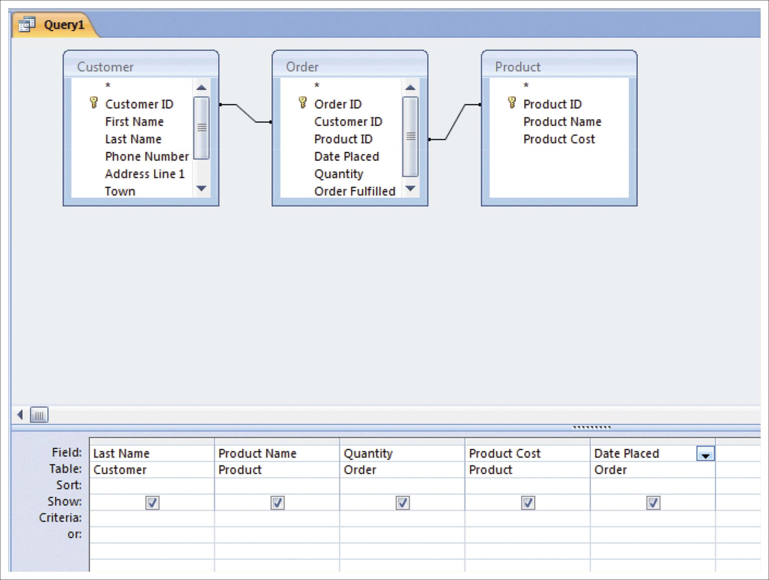
Figure 11.11 Query design screen for the summary query in the Clothez database
Source: Screenshot frame reprinted by permission from Microsoft Corporation

Slide 24
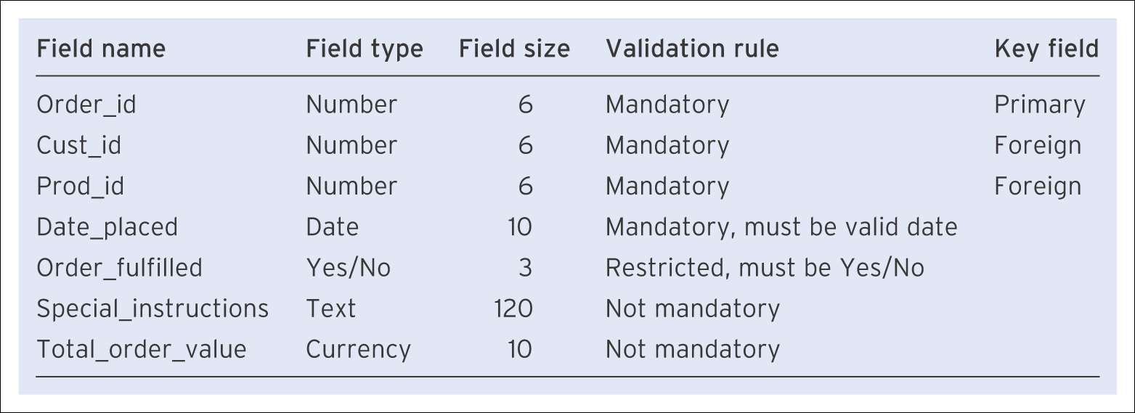
Example field types
Table 11.2 Definition of field details for the order table in the Clothez database (with fields added to show range)

Slide 25
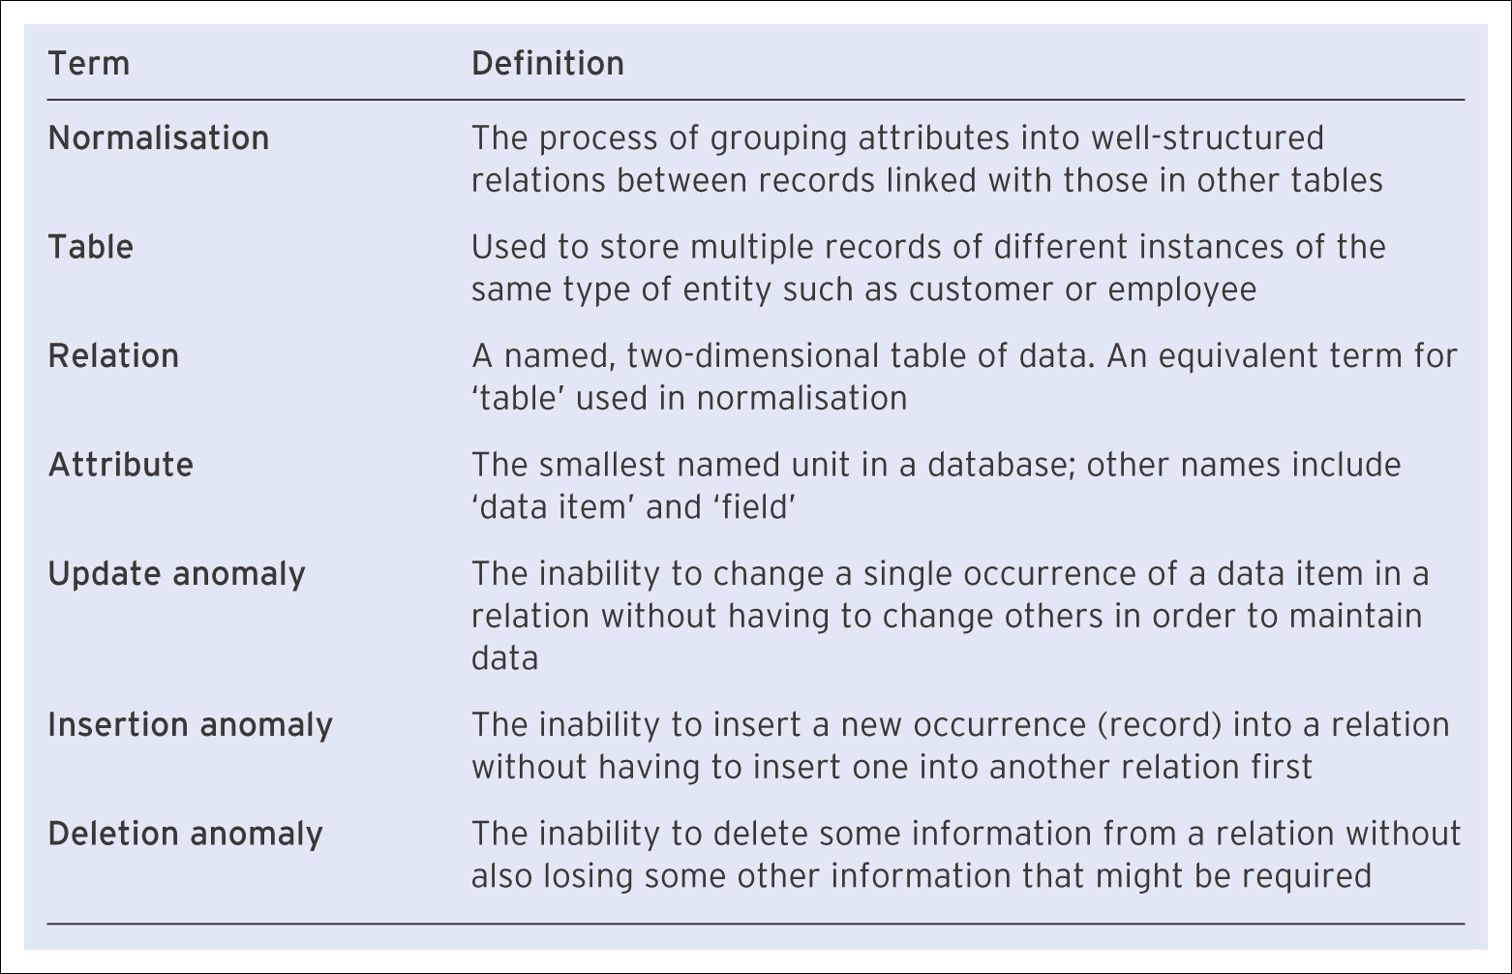
Normalisation concepts
Table 11.3 Summary of terms used to describe databases and normalisation

Slide 26
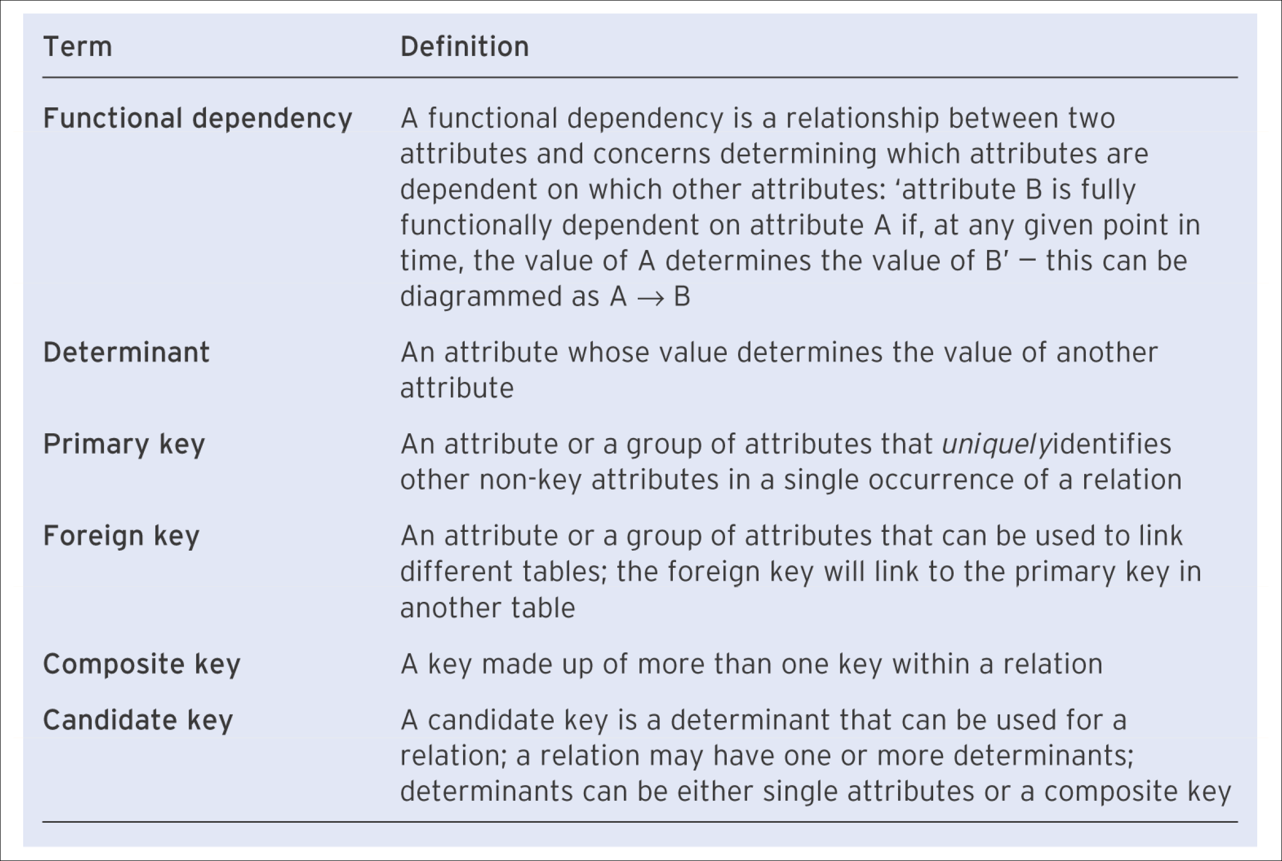
Normalisation concepts (Continued)
Table 11.3 Summary of terms used to describe databases and normalisation (Continued)

Slide 27
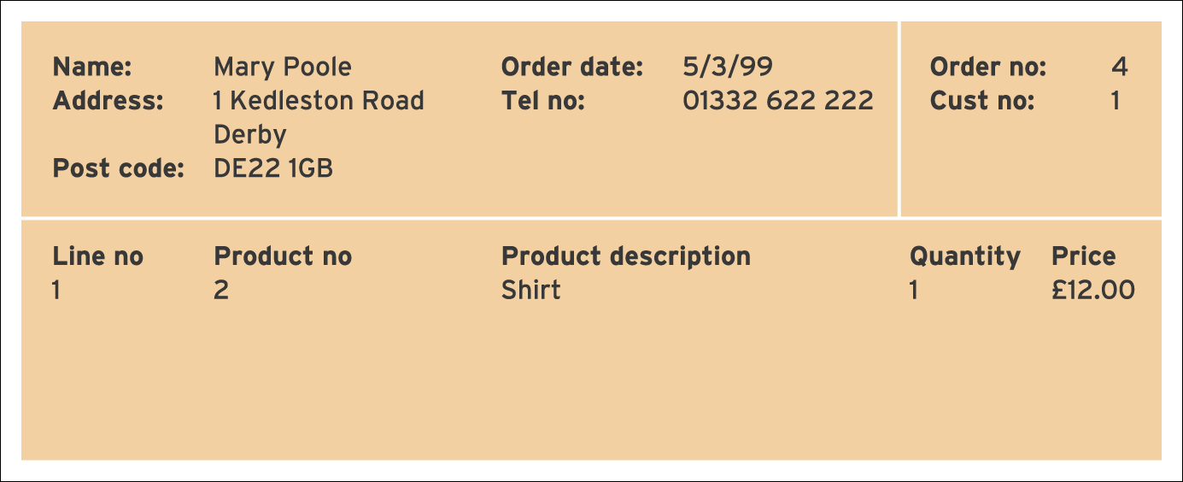
Figure 11.13 Customer order form for the Clothez company

Slide 28
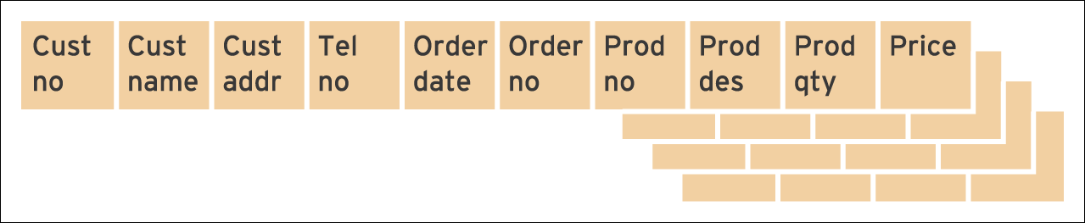
Figure 11.14 Repeating groups for the Clothez database

Slide 29
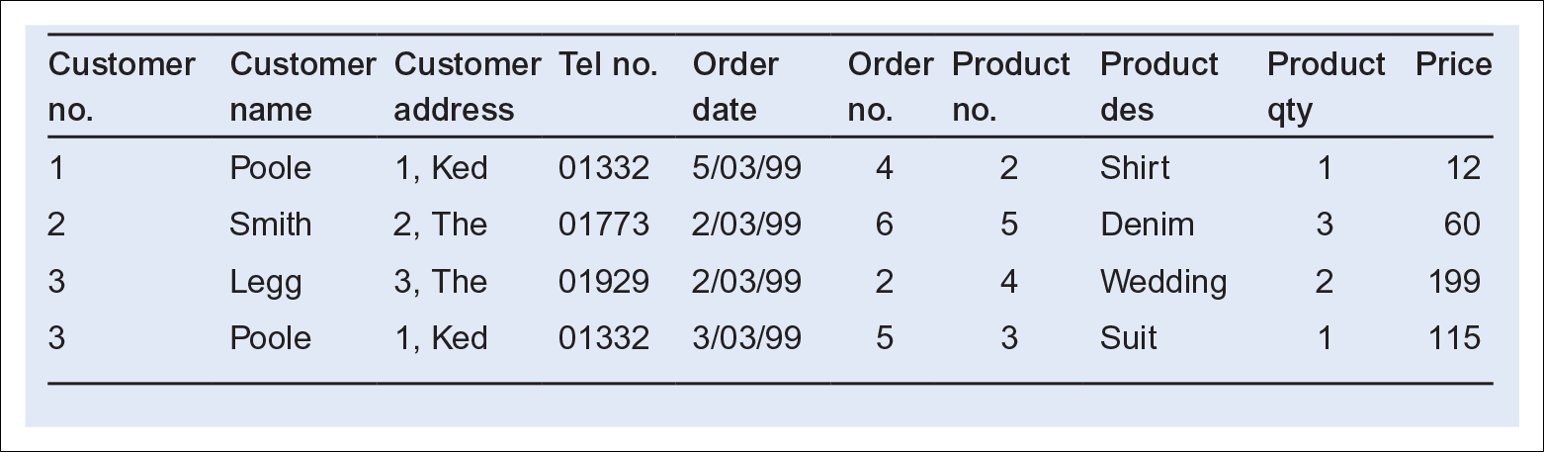
Example anomalies
Table 11.4 Table with example data for the structure shown in Figure 11.14

Slide 30
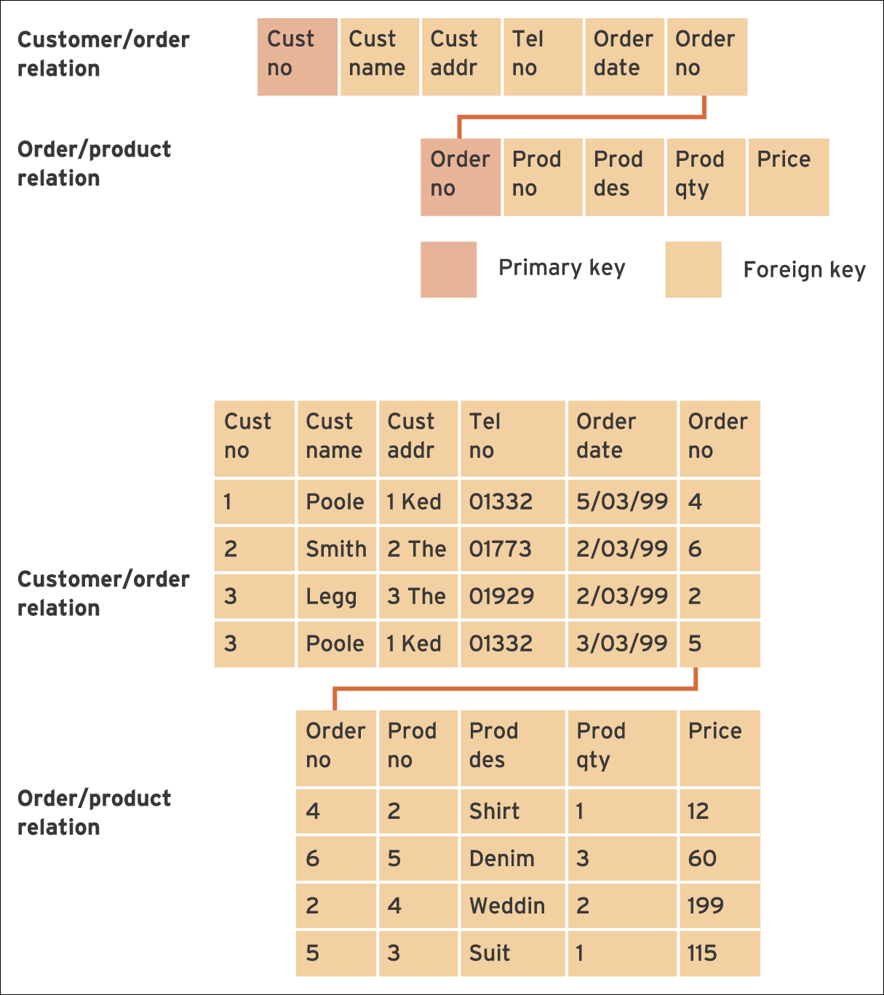
Figure 11.15 The revised table structure and example data for two tables

Slide 31
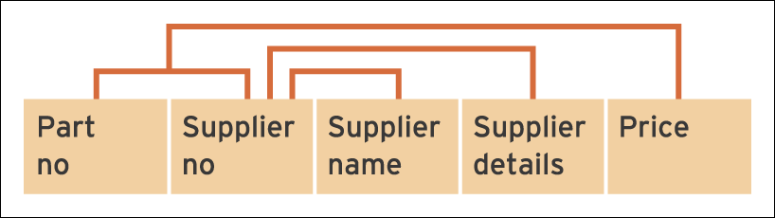
Figure 11.16 Example of a dependency diagram for supplier example

Slide 32
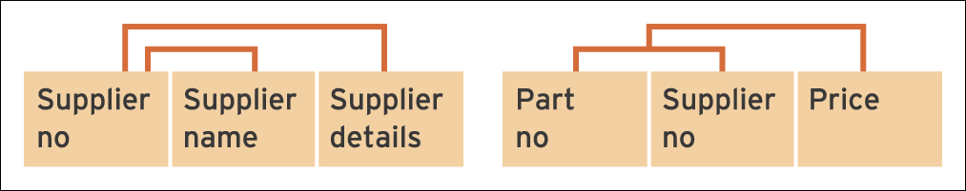
Figure 11.17 Revised dependency diagram for supplier example

Slide 33
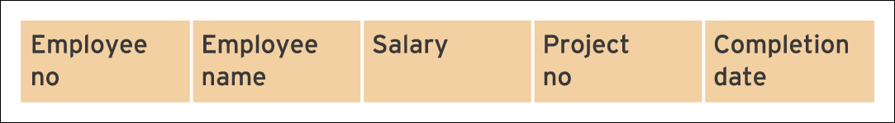
Figure 11.18 Example of a structure diagram – employee details

Slide 34
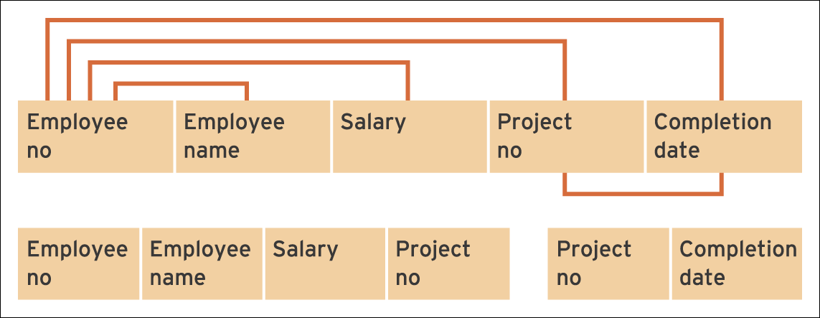
Figure 11.19 Dependency diagram for employee example and revised structure

Slide 35
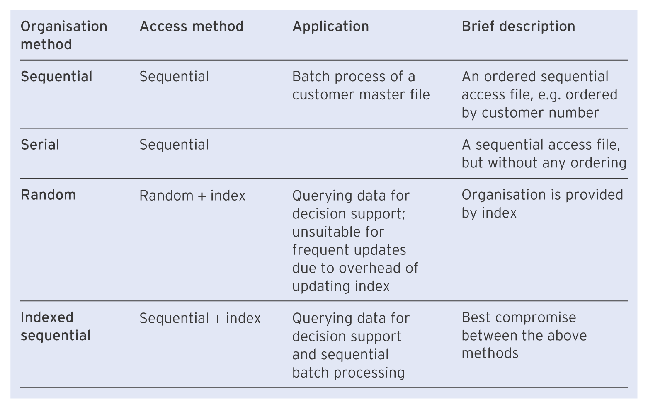
File access methods
Table 11.5 Methods of file organisation

Slide 36
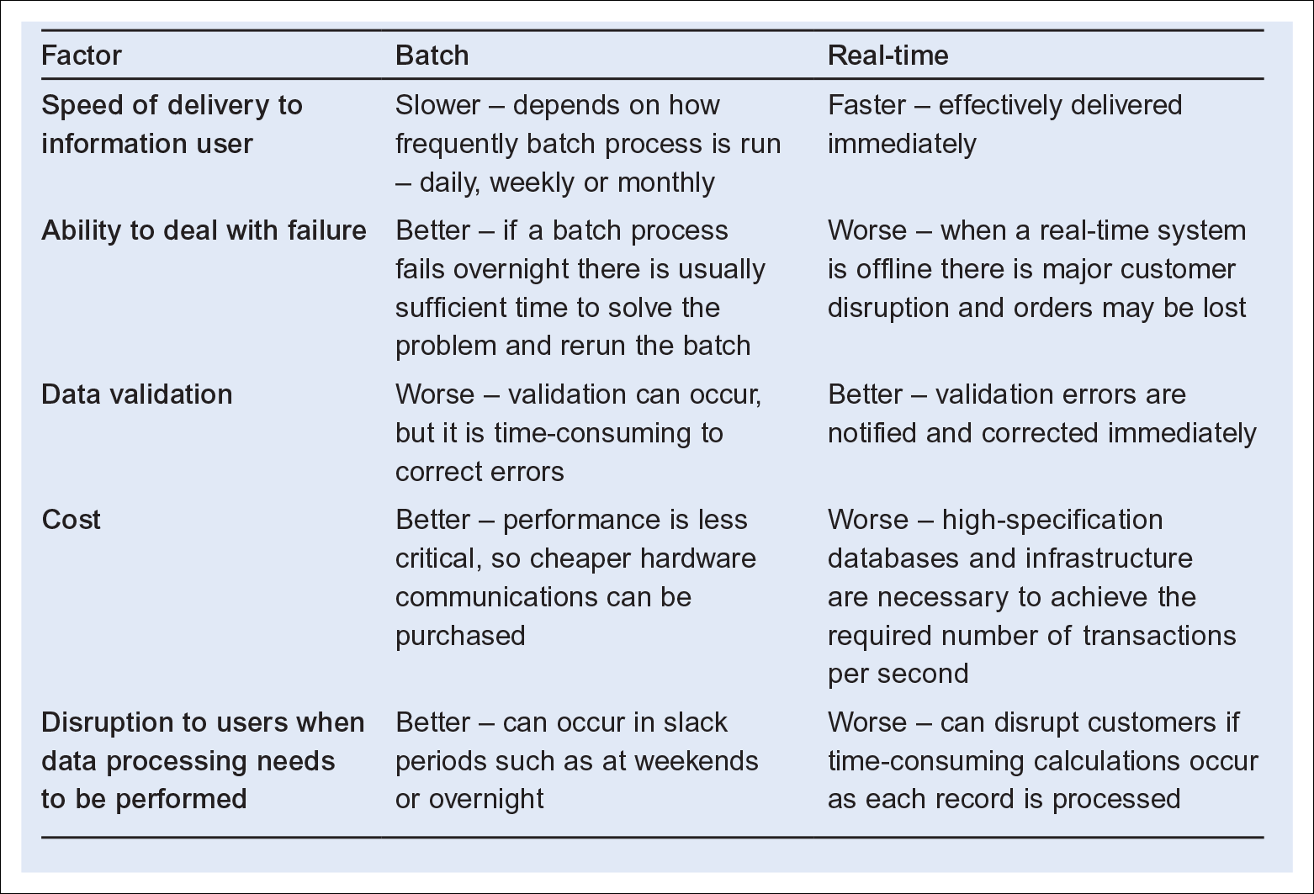
A comparison of batch and real-time data processing
Table 11.6 A comparison of batch and real-time data processing

Slide 37
4. User Interface design
User Interface design involves:
  Defining different views of the data through input forms and output tables
  Defining how the user moves from one view to another
  Providing options for the user.
Field of user interface design is often known as human–computer interaction (HCI).

Slide 38
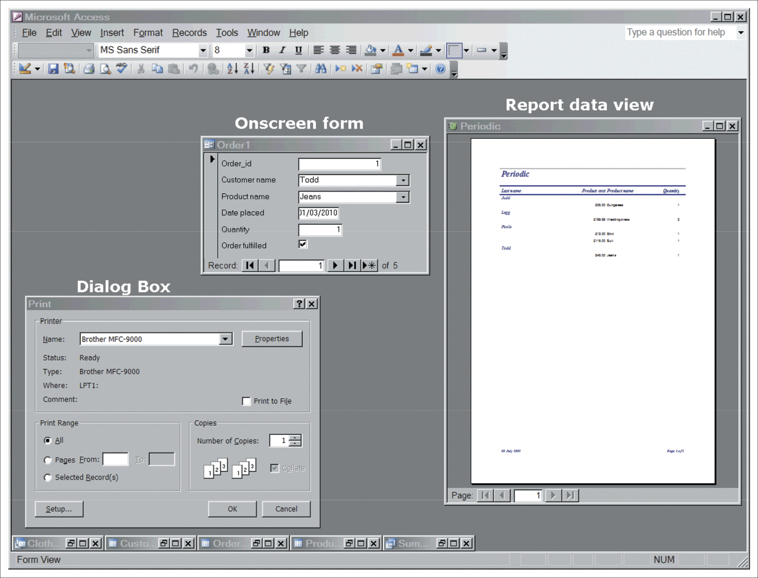
Figure 11.20 Microsoft Access showing key elements of interface design
Source: Screenshot frame reprinted by permission from Microsoft Corporation

Slide 39
5. Security design
The four main attributes of security which must be achieved through design:
Authentication: Authentication ensures that the sender of the message, or the person trying to access the system, is who they claim to be. Passwords are one way of providing authentication, but are open to abuse – users often tend to swap them. Digital certificates and digital signatures offer a higher level of security. These are available in some groupware products such as Lotus Notes.
Authorisation: Authorisation checks that the user has the right permissions to access the information that they are seeking. This ensures that only senior personnel managers can access salary figures, for example.
Privacy: In a security context, privacy equates to scrambling or encryption of messages so that they cannot be easily decrypted if they are intercepted during transmission. Credit card numbers sent over the Internet are encrypted in this way.
Data integrity: Security is also necessary to ensure that the message sent is the same as the one received and that corruption has not occurred. A security system can use a checksum digit to ensure that this is the case and the data packet has not been modified.
Data must also be secure in the sense of not being subject to deletion, or available to people who don’t have the ‘need to know’.

Slide 40
Object-oriented design (OOD)
Object-oriented design (OOD): This is a design technique which involves basing the design of software
on real-world objects which consist of both data and the procedures that process them rather than traditional design where procedures operate on separate data.
Characteristics
  An object consists of data and methods that act on them.
  Objects communicate using messages which request a particular service from another object, such as a ‘print current balance’ service. These services are known as methods and are equivalent to functions in traditional programming.
  Objects are created and destroyed as the program is running.

Slide 41
OOD characteristics (Continued)
4. Objects provide encapsulation – an object can have private elements that are not evident to other objects. This hides complex details and gives a simple public object interface for external use by other objects.
Abstraction refers to the simplified public interface of the object.
5. Objects can be grouped into classes which share characteristics. Classes can share characteristics with other classes in the hierarchy, which is known as inheritance. This refers to the situation when an object inherits the behaviour of other objects.
Polymorphism, where an object can modify its inherited behaviour.

Slide 42
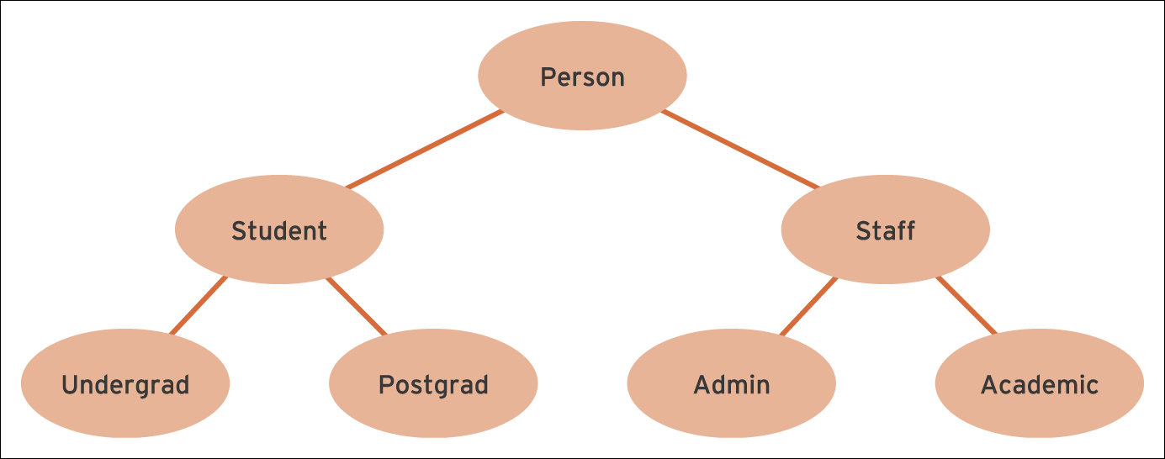
Figure 11.21 A class hierarchy for different types of people at a university

